Slide 1
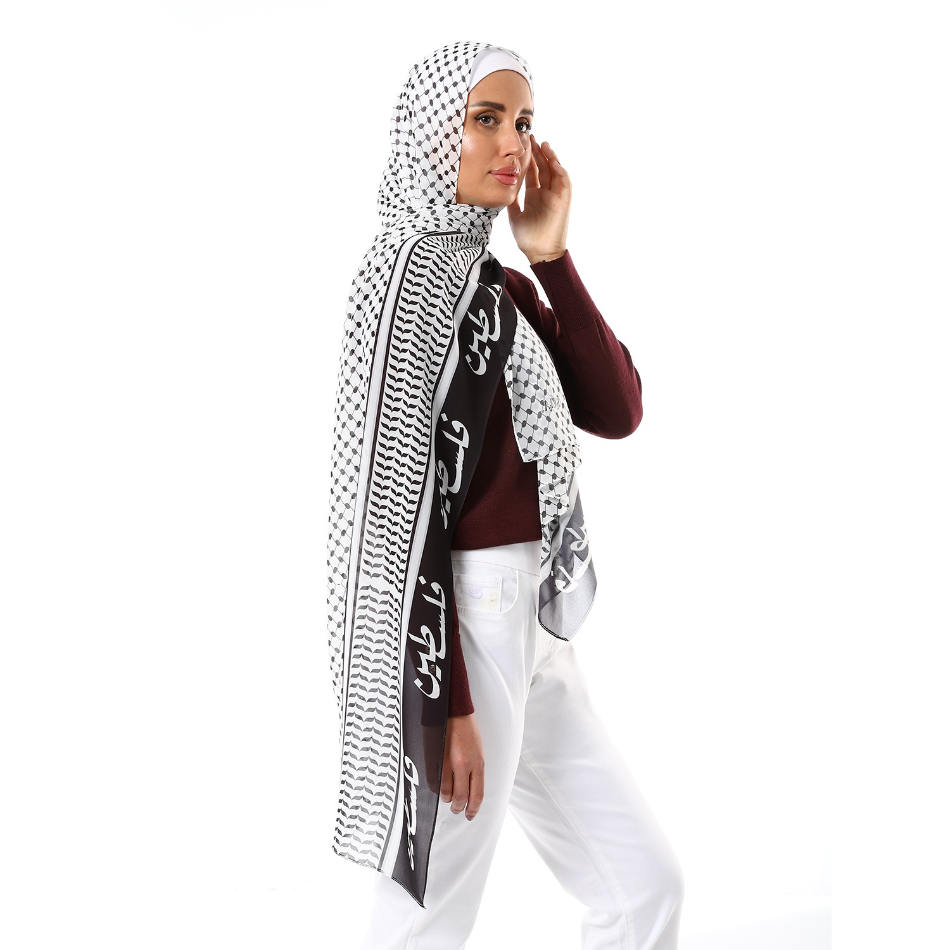


Slide 2

AGENDA
INTRODUCTION
Swot analysis
Buyer persona
usp
strategy & business goals
Action plan

Slide 3
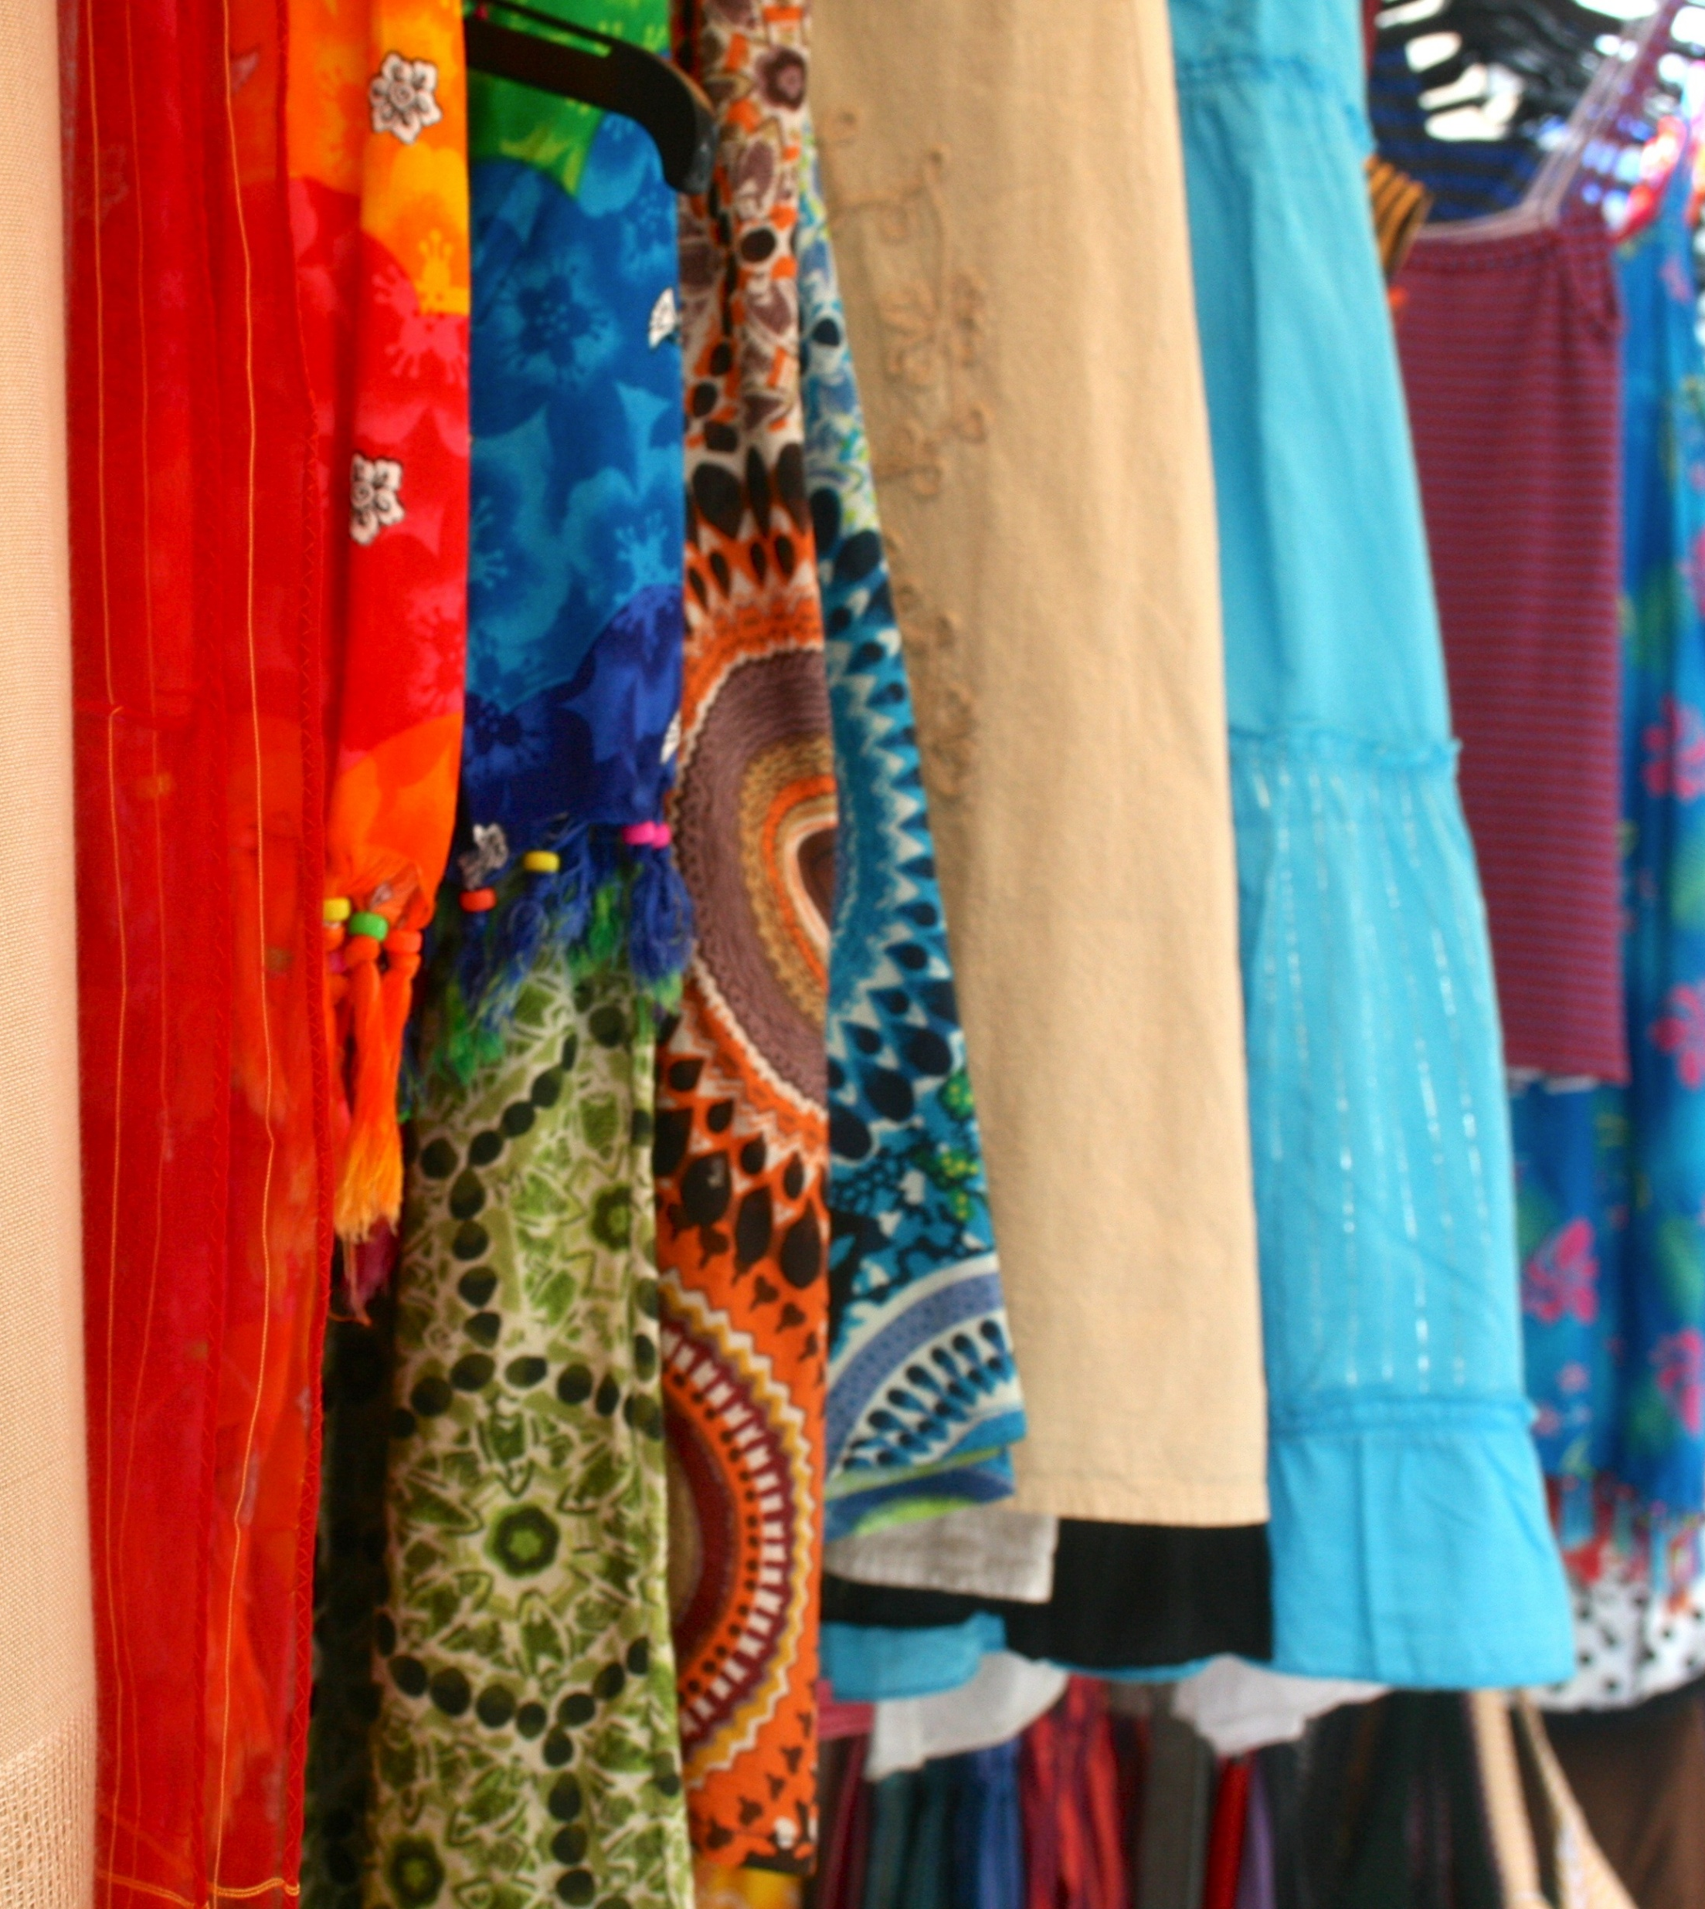
introduction
K.TiTi – Modern Fashion, Effortlessly Stylish
K.TiTi is a contemporary fashion brand that blends style, comfort, and practicality. Crafted from premium fabrics and designed with a focus on simplicity and elegance, every piece transitions seamlessly from casual outings to workdays to special occasions. With K.TiTi, fashion becomes accessible, versatile, and timelessly chic.

Slide 4

Swot analysis
Strengths: Youthful designs – Affordable prices – Clear exchange policy.
Weaknesses: New brand – Limited awareness so far.
Opportunities: Large audience of female students + Growth of online shopping.
Threats: Strong competitors – Potential shipping issues.

Slide 5
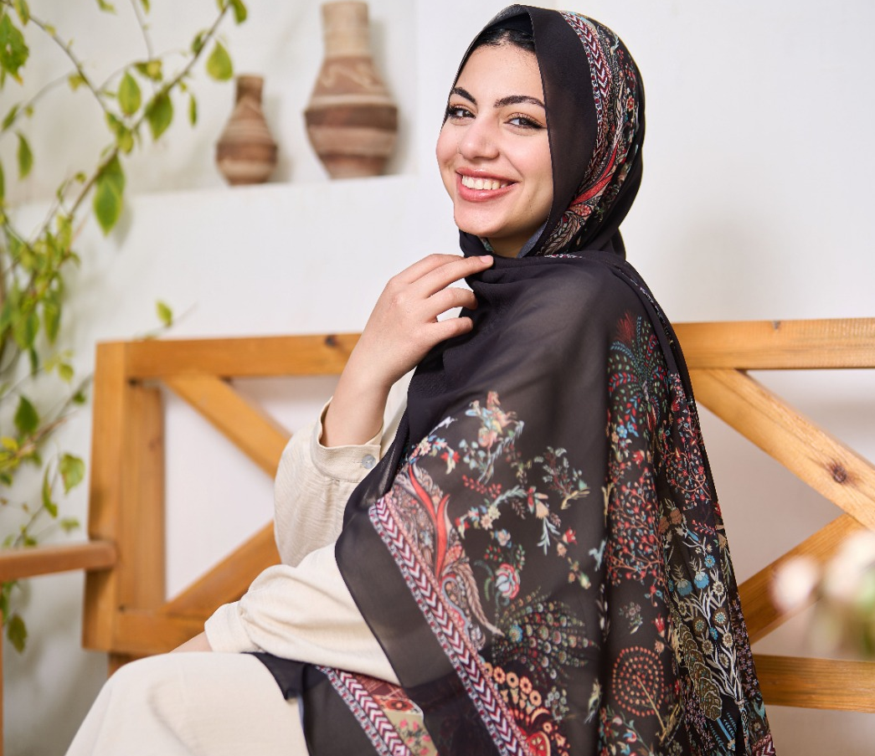
Buyer Persona
👩‍🎓 Age: 18–24, university students
🎀 Style Preference: Fashionable yet practical
💸 Shopping Motivation: Affordable + high quality + easy online shopping
📱 Influences: Visual-first (photos & videos > long texts)
✨ What She Values: Effortless outfits that keep her looking chic without breaking the bank

Slide 6

USP (Unique Selling Proposition)
Why K.TiTi ?
👗 Comfort All Day – Premium fabrics that feel good from morning lectures to evening hangouts.
🌸 On-Trend Style – Modern, chic designs made for young women who want to look stylish without the fuss.
⚡ Hassle-Free Experience – Easy exchanges and responsive customer support for peace of mind.
🎓 Student Perks – Special discounts and offers tailored for university students.

Slide 7

Strategy & business goals
🎯 Strategy Goals
✨ Boost Awareness – Reach more university girls and make K.TiTi a familiar name.
📲 Drive Engagement – Build strong, consistent content on Facebook & Instagram that sparks interaction.
💼 Business Goals
💸 Steady Sales – Achieve consistent monthly revenue growth.
❤️ Brand Trust & Love – Become a go-to brand known for quality and reliability.
🌍 Expansion – Grow into more cities and university communities in the future.

Slide 8

Action plan
Mostafa - - Facebook& Ads
Waleed -- Facebook & Ads
Ahmed -- Facebook & Content Creation
Abdelrhman – Instagram & Content Creation
Ali – Instagram & Content Creation
Mohamed – Instagram & Ads

Slide 9
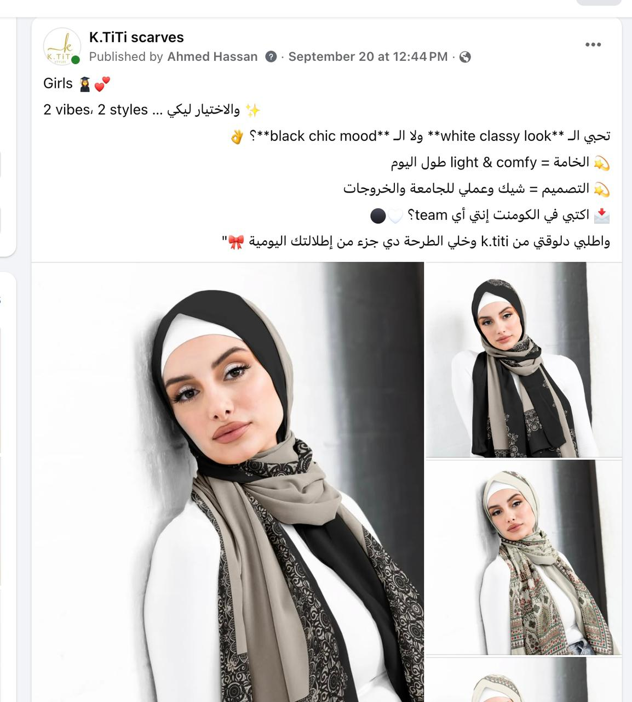
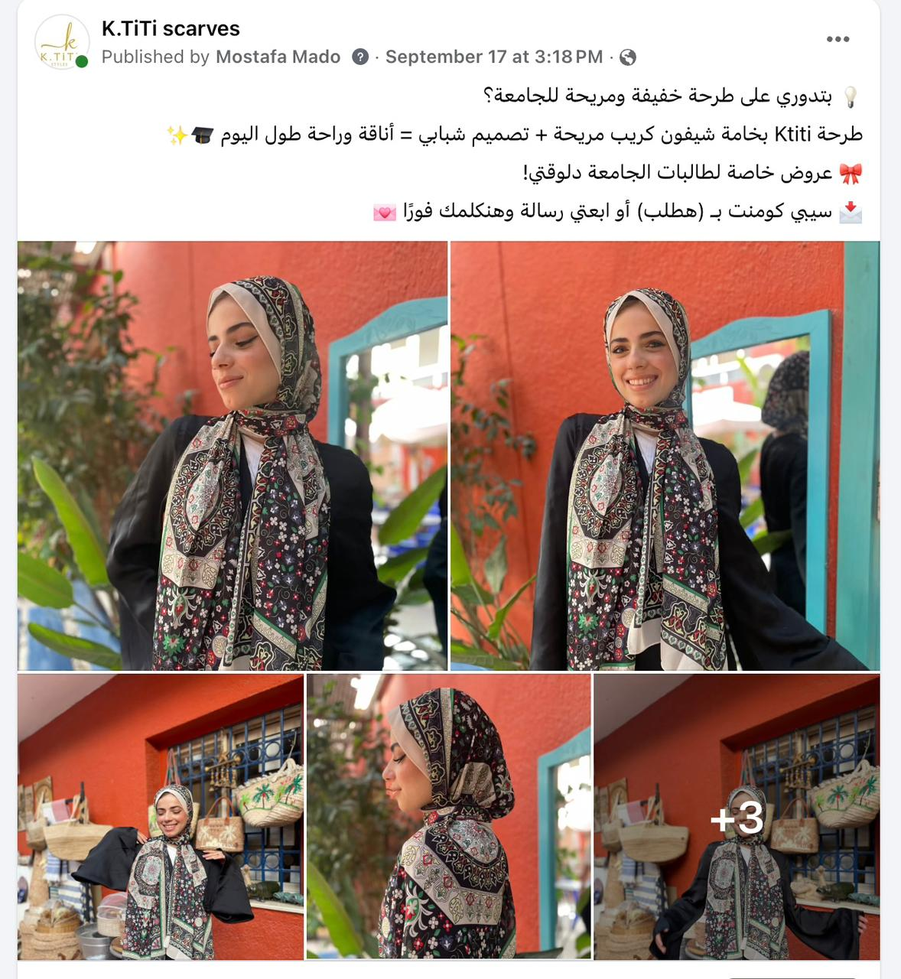
result

Slide 10
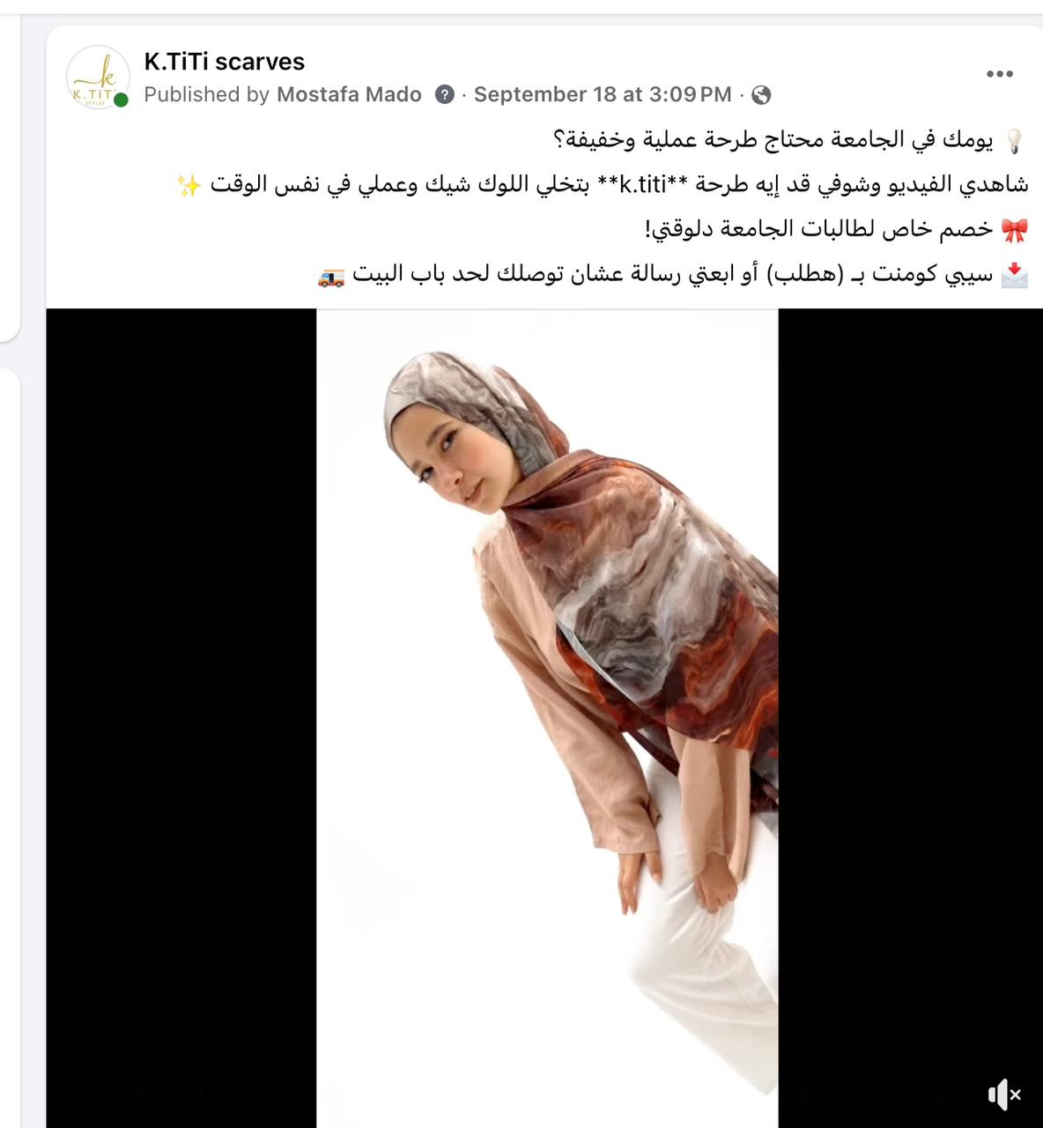
Facebook posts

Slide 11
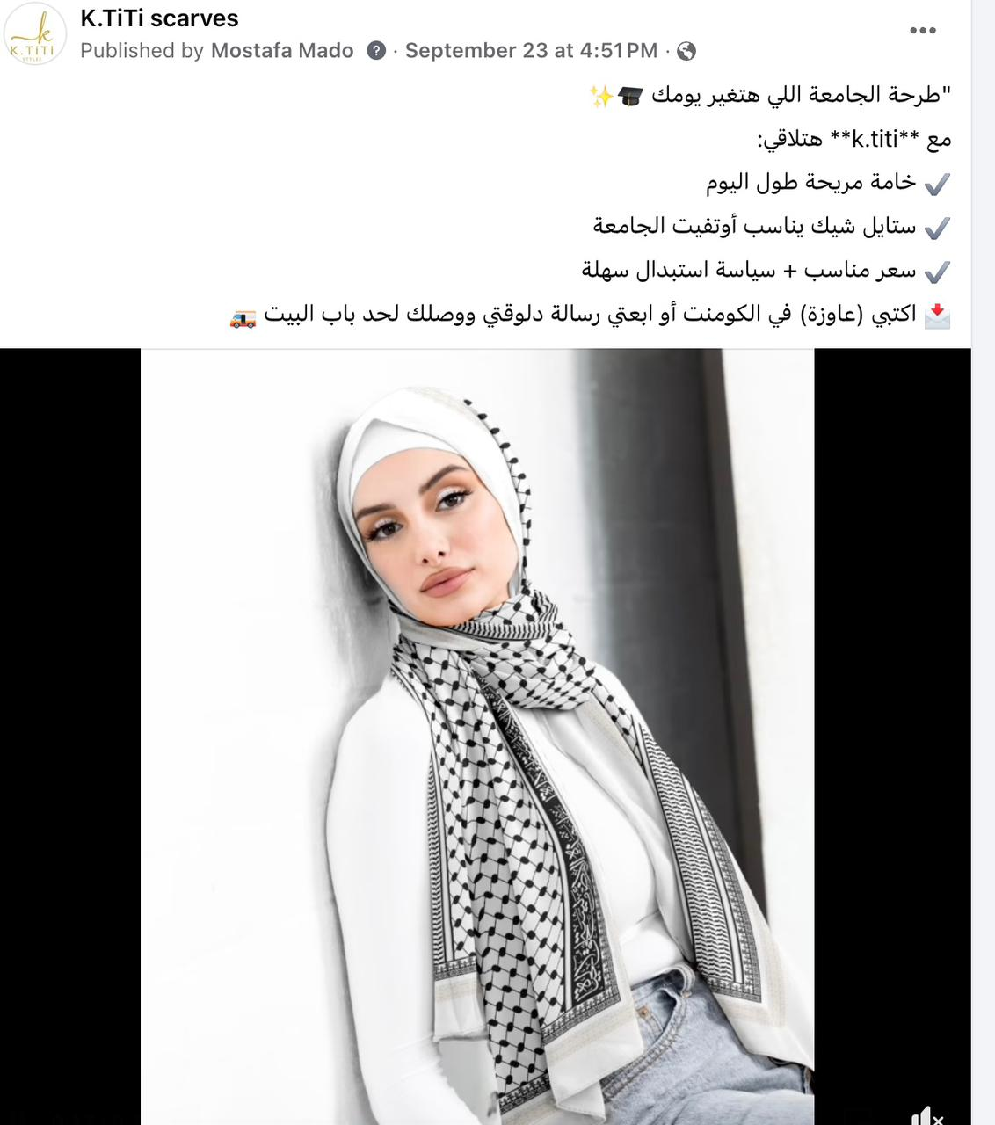
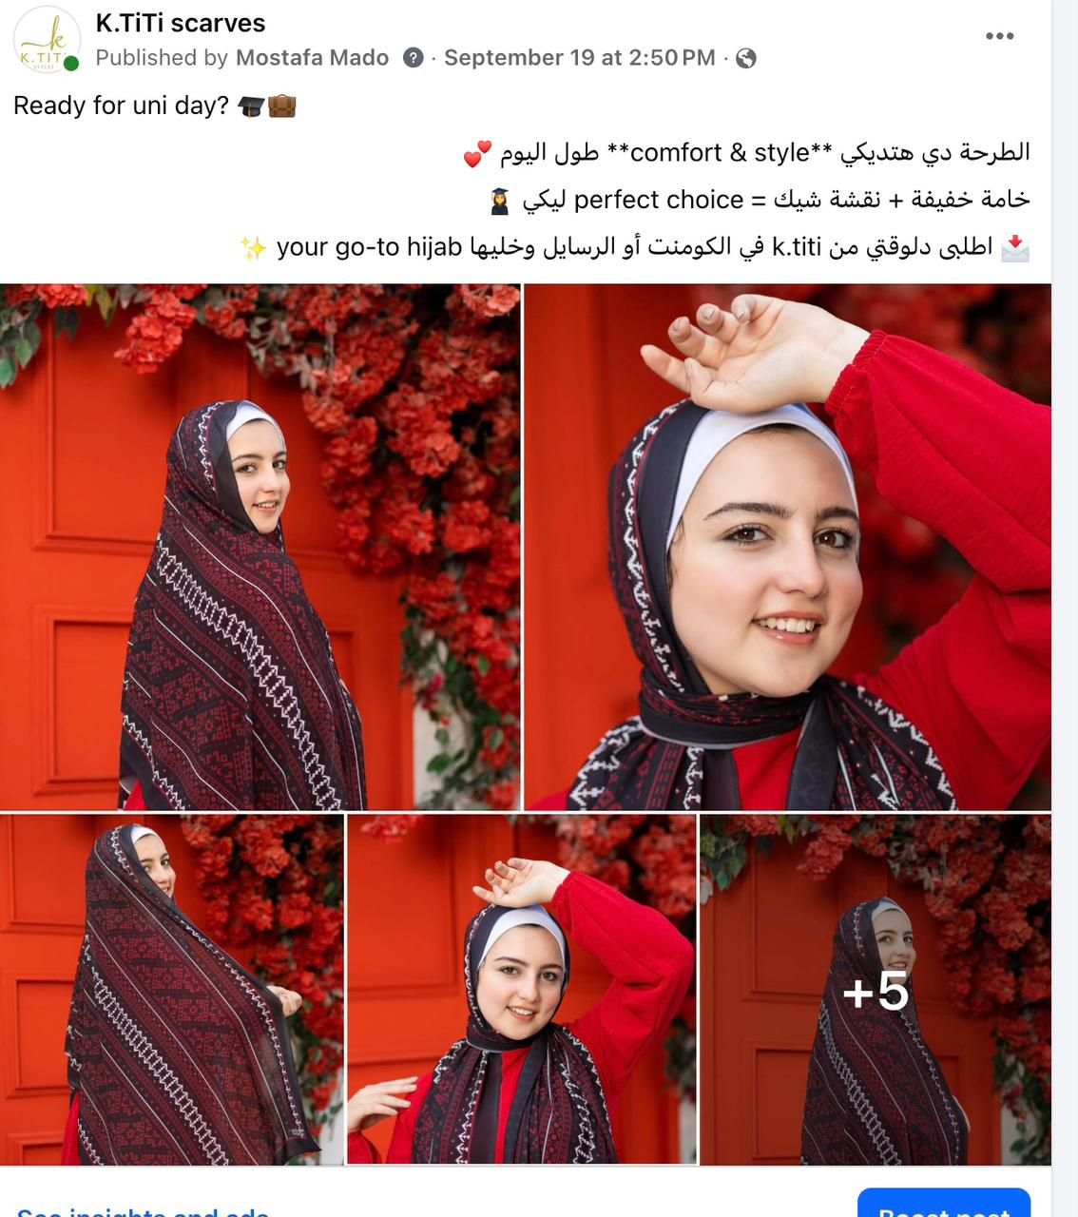
Facebook posts

Slide 12
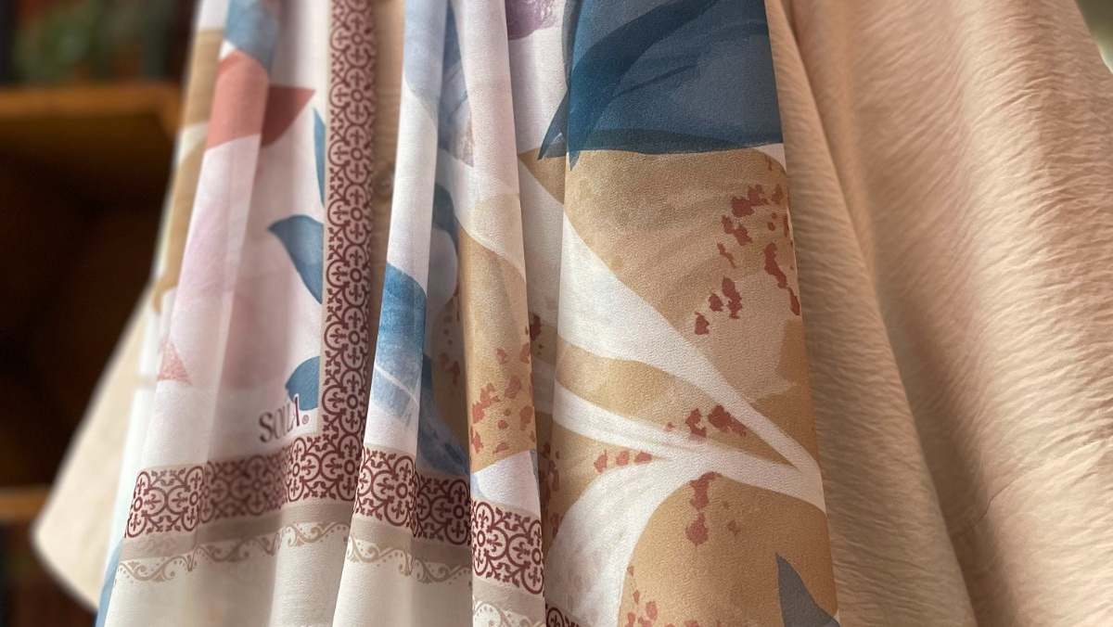
Where Comfort Meets Style.

